Slide 1
Unit-3 Problem Solving by Searching
Presented By:
Safalta Joshi
Sameer Maharjan
Sujal Shrestha
Sakshyam Tamrakar
Suhana Shrestha
Yukesh Maharjan

Slide 2
Search in AI
Search is an essential component of artificial intelligence (AI) because it enables machines to find solutions to complex problems within a vast search space. Example:
In the 8-puzzle, a state is one specific arrangement of tiles.

Slide 3
Problem-Solving Agents
A problem-solving agent is a type of goal-based agent that plans actions to achieve specific goals. Operate in simple environments with clear goals and fixed sequences of actions.
The agent works through a four-phase problem-solving process:
Goal Formulation
Problem formulation
Search Method
Execute

Slide 4
Well-defined Problems
A Well-Defined Problem has all five components clearly specified.
Examples: 8-Puzzle
The five components are:
1. Initial State — where does the agent start?
2. Actions — what can the agent do?
3. Transition Model — what is the result of each action?
4. Goal Test — how do we know we've reached the goal?
5. Path Cost — what is the cost of reaching the goal?

Slide 5
Solving Problems by Searching
Searching is the process of systematically exploring the state space to find the goal.
The agent generates a search tree — a tree of states reachable from the initial state.
Important terms:
Node — a state in the search tree with parent info & cost
Frontier — the set of nodes waiting to be explored
Explored Set — states already visited (to avoid loops)

Slide 6
Performance Evaluation of Search Techniques
We evaluate a search algorithm using four criteria:
1. Completeness — Does it always find a solution if one exists?
2. Optimality — Does it find the best solution?
3. Time Complexity — How long does it take?
4. Space Complexity — How much memory does it use?

Slide 7
Search Strategies
Uniformed Search
Depth First Search
Breadth First Search
Depth Limited Search
Iterative Deepening Search
Bidirectional Search
Informed Search
Greedy Best First Search
A* Search
Hill climbing
Stimulated Annealing
Game Playing
Adversarial Search Techniques
Mini-max Search
Alpha-Beta Pruning

Slide 8
Uninformed Search
Uninformed search does not use any domain knowledge to guide the search process.
This method uses a brute force approach (explores all possibilities) to find the solution.
It can be time consuming but often finds the correct solution.

Slide 9
Types of Uninformed Search
Breadth First Search(BFS)
Depth First Search(DFS)
Depth Limited Search(DLS)
Iterative Deepening DFS (IDDFS)
Uniform Cost Search (UCS)
Bidirectional Search

Slide 10
Breadth First Search (BFS)
Breadth First Search explores the state space level by level.
It starts from the root node and expands all neighboring nodes first.
It visits all nodes at the current level before moving deeper.
This algorithm uses a queue that follows the FIFO principle.

Slide 11
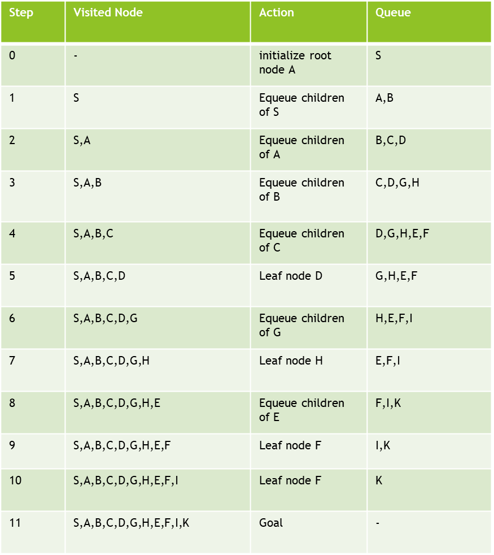
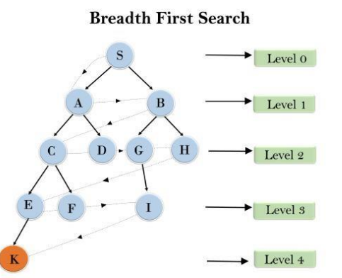
Traversed path is
S--->A--->B---->C--->D---->G--->H--->E---->F---->I---->K

Slide 12
Depth First Search (DFS)
Depth First Search explores the deepest node in the search tree first.
It starts from the root node and moves as deep as possible.
When it reaches a dead end, it backtracks to explore other paths.
This algorithm uses a stack that follows the LIFO principle.

Slide 13
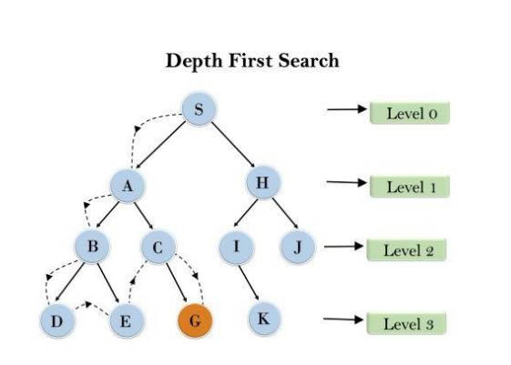
Step | Node Popped | Action | Stack(Top to bottom) | Visited Node
0 | - | Initialize with node A | S
1 | S | Push children of S | A,H | S
2 | A | Push children of A | B,C,H | S,A
3 | B | Push children of B | D,E,C,H | S,A,B
4 | D | Leaf node, backtrack | E,C,H | S,A,B,D
5 | E | Leaf node, backtrack | C,H | S,A,B,D,E
6 | C | Push children of C | G,H | S,A,B,D,E,C
7 | G | Leaf node, backtrack | H | S,A,B,D,E,C,G
8 | H | Push children of C | I,J | S,A,B,D,E,C,G,H
9 | I | Push children of C | K,J | S,A,B,D,E,C,G,H,I
10 | K | Leaf node, backtrack | J | S,A,B,D,E,C,G,H,I,k
11 | J | Goal Node found |  | S,A,B,D,E,C,G,H,I,K,J
Traversed path is
S--->A--->B---->D--->E---->C--->G--->H---->I---->K---->J

Slide 14
Depth Limited Search (DLS)
Depth Limited Search is an extension of Depth First Search.
It introduces a fixed depth limit to control the search process.
The algorithm stops expanding nodes when the depth limit is reached.
It helps in preventing infinite loops in deep or infinite search spaces.
It may result in standard failure or cutoff failure.

Slide 15
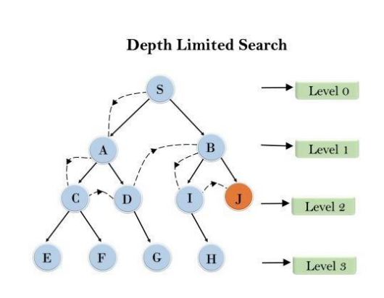
For example:
Limit= 2
Traversed Path: S--->A--->C---->D--->B---->I---->J

Slide 16
Iterative Deepening DFS (IDDFS)
Iterative Deepening Depth First Search combines the features of DFS and BFS.
It performs depth-limited search repeatedly with increasing depth limits.
The depth limit is increased step by step until the goal is found.
This method ensures systematic exploration of the search space.

Slide 17
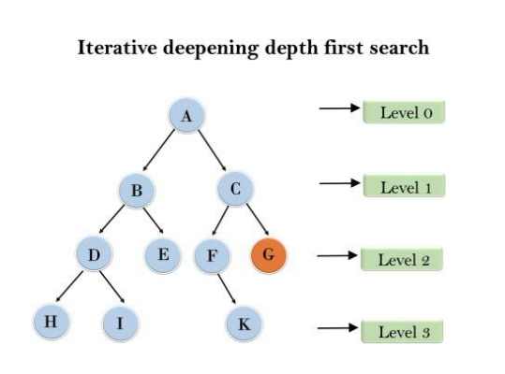
1'st Iteration-----> A
2'nd Iteration----> A, B, C
3'rd Iteration------>A, B, D, E, C, F, G
In the third iteration, the algorithm will find the goal
node.

Slide 18
Uniform Cost Search (UCS)
Uniform Cost Search finds the path with the least cumulative cost.
It is mainly used in weighted graphs where costs are involved.
The algorithm uses a priority queue to select the lowest cost node.
A node is updated only if a lower cost path is found.

Slide 19
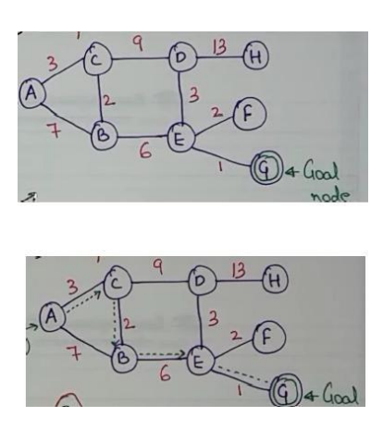
Step | Priority Queue | Explored
0 | (A,cost=0) | {}
1 | (C,3),(B,7) | {A}
2 | (B,5),(D,12) | {A,C}
3 | (E,11),(D,12) | {A,C,B}
4 | (D,12),(G,12),(F,13) | {A,C,B,E}
5 | (G,12),(F,13),(H,25) | {A,C,B,E,D}
6 | Goal Node Reached | {A->C->B->E->G}

Slide 20
Bidirectional Search
Bidirectional search runs two searches simultaneously.
One search starts from the initial state and moves forward.
The other search starts from the goal state and moves backward.
The process stops when both searches meet at a common node.
It can be implemented using BFS or DFS.

Slide 21
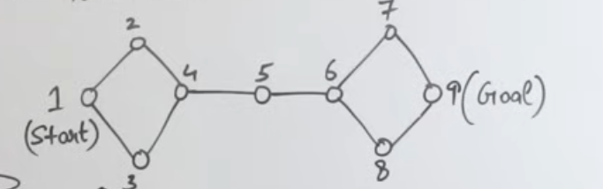

Slide 22
Concepts of Informed Search
Informed Search (also known as Heuristic Search) is a strategy that uses domain-specific knowledge to find solutions more efficiently than "blind" search methods like BFS or DFS.
The "Information" in informed search comes from a Heuristic Function, denoted as h(n).
Informed search uses a function:
f(n)=g(n)+h(n)
g(n) → actual cost from start → current node
h(n) → estimated cost from current node → goal (heuristic)

Slide 23
How Decision Are Made : Evaluation Function(f)
Informed Search Algorithm use an Evaluation Function f(n) to decide which node is visit next.They always pick lowest value
Greedy Best-First Search: $f(n) = h(n)
Only looks at the estimated distance to the goal.
A Search:* f(n) = g(n) + h(n) Look at the cost already spent(g) plus the estimate distance of the goal(h)

Slide 24
Strategies of Informed Search
Greedy Best-First Search (GBFS)
A* Search (A-Star)

Slide 25
Greedy Best-First Search (GBFS)
Greedy Best-First Search is an Informed Search algorithm that uses a heuristic to guide its path toward a goal.
It is called "Greedy" because at each step, it picks the path that appears to provide the most immediate benefit, without considering the total journey cost.
Evaluation Function : f(n)=h(n) n : The current node being evaluated.
h(n): The Heuristic Function. This is an estimate of the cost from node n to the goal

Slide 26
Step-by-Step Process
Initialize: Place the Starting Node into the OPEN list.
Check Empty: If the OPEN list is empty, return Failure (no solution exists).
Select Best: Remove the node with the lowest h(n) value from the OPEN list. Let’s call this the Current Node.
Goal Test: If Current Node is the Goal Node, return Success and stop.
Expand: For each neighbor of the Current Node:
If the neighbor is not in the OPEN or CLOSED lists:
Calculate its heuristic value h(neighbour)
Add the neighbor to the OPEN list.
Close: Move the Current Node to the CLOSED list.

Slide 27
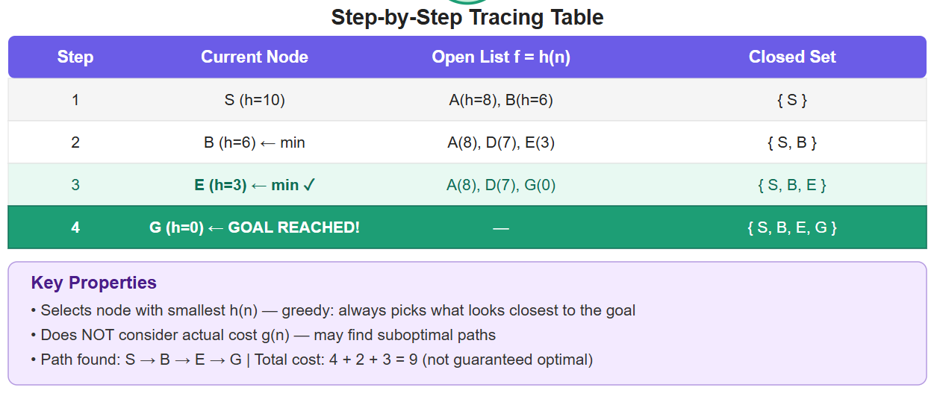
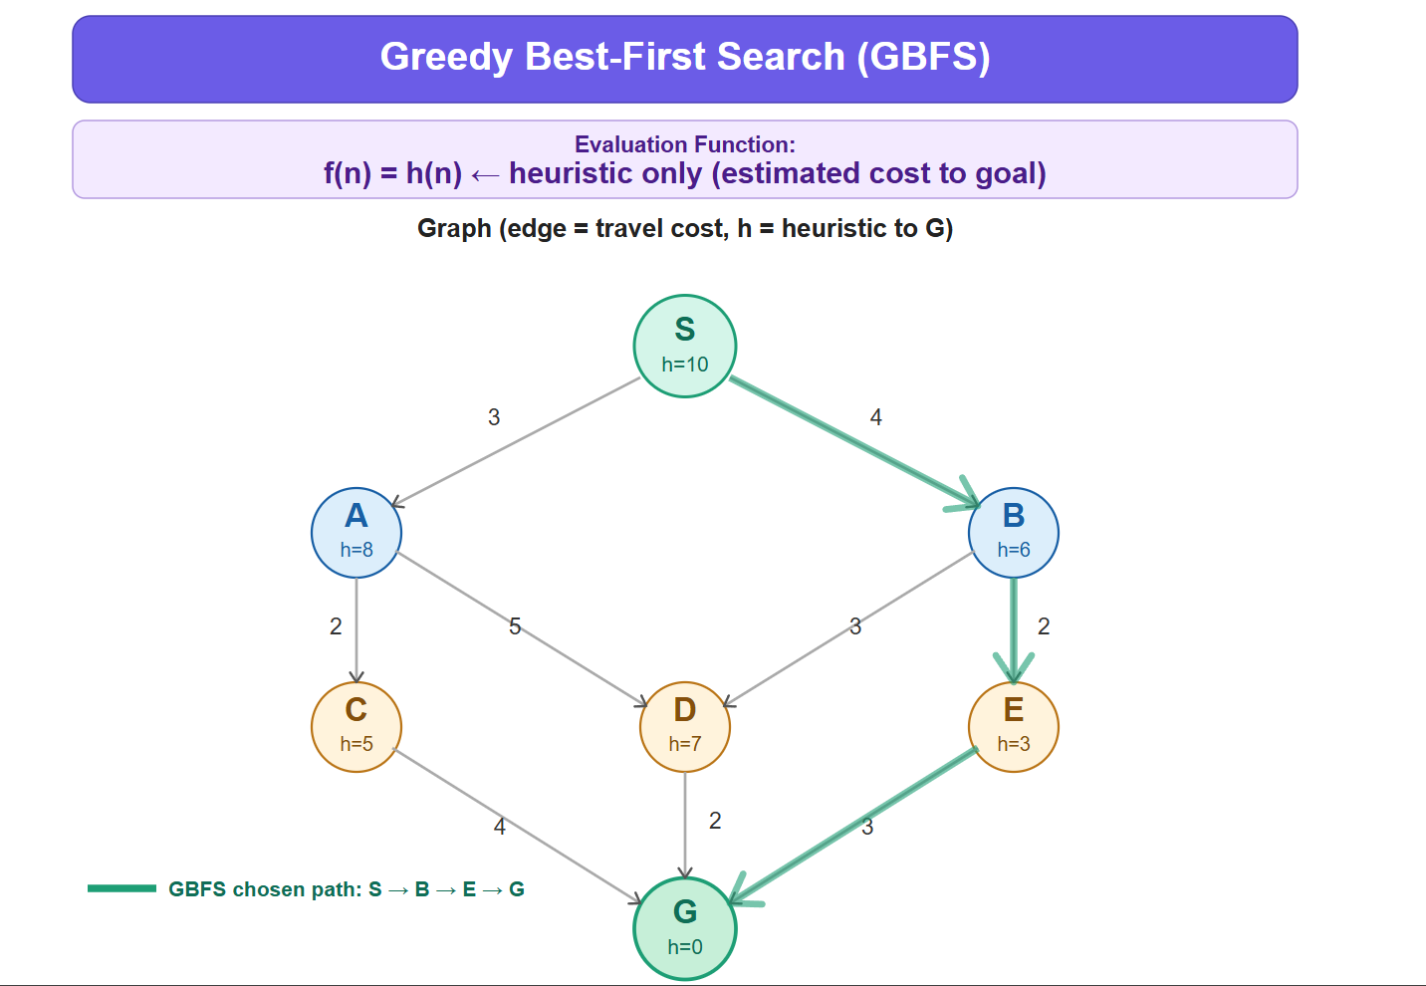

Slide 28
Advantages of GBFS
Speed (Efficiency) :GBFS is typically much faster than uninformed search (like BFS or DFS) because it doesn't explore every possibility.
Reduced Memory Usage : Since it tends to find a path quickly, it doesn't need to store as many nodes in the "Open List" compared to algorithms that explore broadly.
Simple to Implement : No need to track full path cost properly

Slide 29
Disadvantages of GBFS
Not Complete: If you don't keep track of visited nodes (a "Closed List"), GBFS can get stuck in an Infinite Loop.
Not Optimal: This is the biggest drawback. As you saw in your previous cost calculation(1+3+1=5),
GBFS might pick a path that looks short but actually costs more than another path it ignored.

Slide 30
A*Search
A* Search is the "gold standard" of pathfinding algorithms. It is an informed search algorithm that combines the best parts of Uniform Cost Search (which is safe but slow) and Greedy Best-First Search (which is fast but risky).
A* is a smart pathfinding algorithm that doesn’t blindly explore like BFS or DFS.
It uses this formula:
f(n)=g(n)+h(n)
g(n) = actual cost from start → current node
h(n) = estimated cost from current node → goal
f(n) = total estimated cost of the path through that node

Slide 31
Step-by-Step Process
Step 1: Initialize
Put start node in OPEN list
f(A) = g(A) + h(A)
Step 2: Loop
Repeat:
Pick node with lowest f(n)
Move it to CLOSED list (visited)
Expand neighbors
For each neighbor:
Calculate:
g(n)
h(n)
f(n)
If better path found → update it
Step 3: Stop
When goal node is selected → DONE
Backtrack to get path

Slide 32
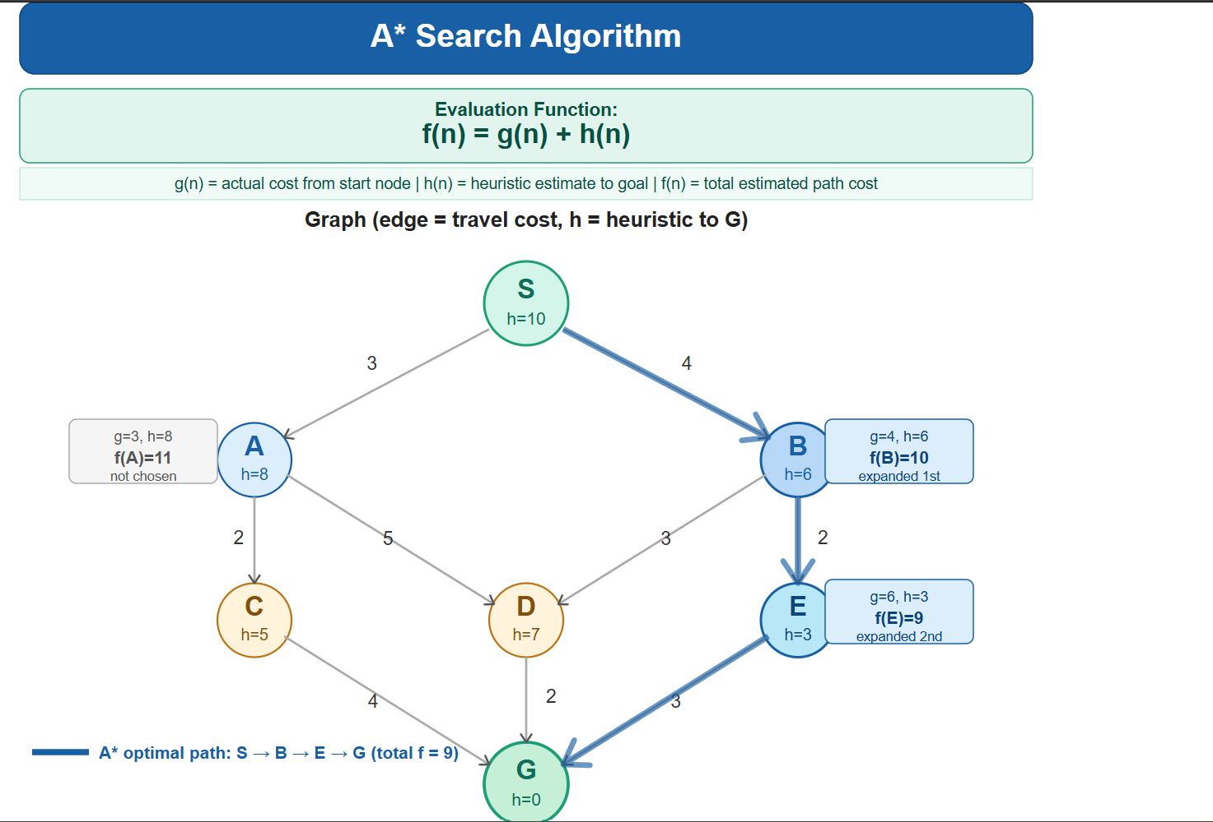
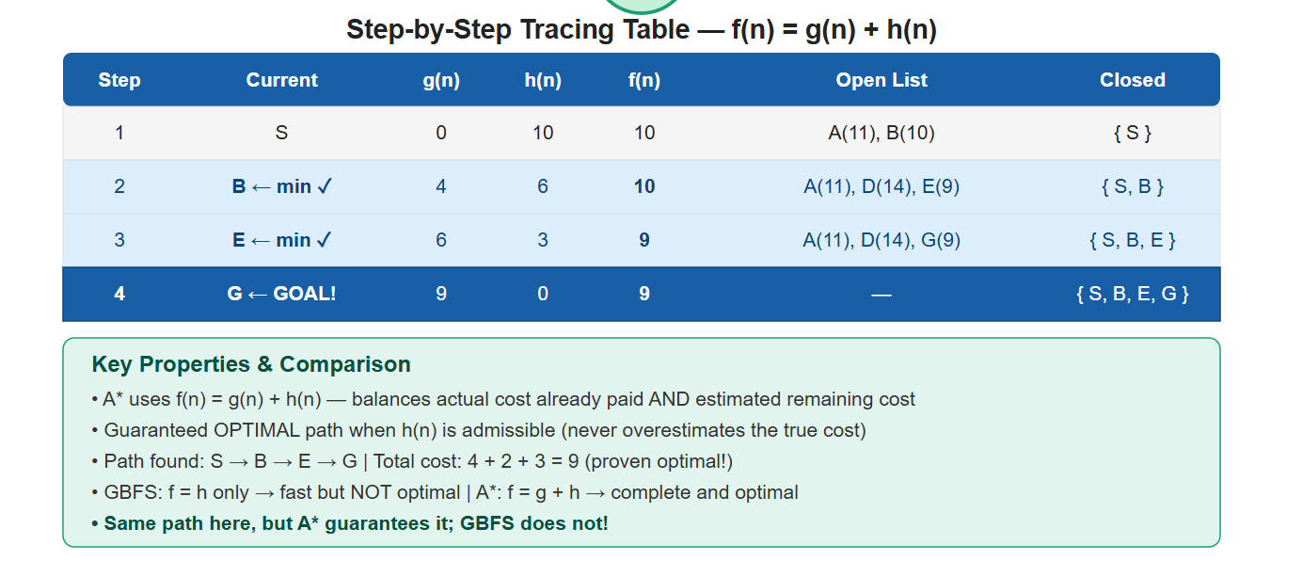

Slide 33
Advantages of A* Search
Optimal Solution : If heuristic is admissible (never overestimates), A* gives the shortest path
Better than Greedy Search : Greedy uses only h(n) → can give wrong path
More Efficient than Dijkstra : Uses h(n) to guide search
Doesn’t explore useless nodes

Slide 34
Disadvantages of A* Search
High Memory Usage (Big Problem) : Stores all nodes in OPEN and CLOSED lists
For large graphs → memory explodes
This is the main weakness, not optional
Time Complexity Can Still Be High : Worst case: explores almost all nodes

Slide 35
Conclusion
Use GBFS when : You need a solution immediately and you don't care if it's the absolute shortest path. It is ideal for massive maps where calculating the perfect path would take too much time (e.g., simple AI in a video game).
Use A* Search when: The cost matters. If you are building a GPS (Google Maps) or a logistics system where saving fuel/time is the priority, A* is the only choice because it ensures you never take a sub-optimal route.

Slide 36
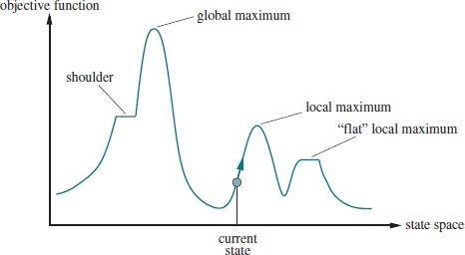
Local Search & Optimization
Searches from a start state to neighboring states.
Does not track full paths or visited states.
Not systematic — may miss parts of the solution space.
Well-suited for optimization problems.
Uses a state-space landscape where elevation = objective function value.
Global Maximum: the best possible solution (aim for peaks).
Global Minimum: lowest cost state (aim for valleys).

Slide 37
Hill Climbing Search
Start at an initial state.
Look at all neighboring states.
Move to the neighbor with the highest value.
If no neighbor is better, stop — you are at a peak.
Also called greedy local search — always takes the best next step.

Slide 38
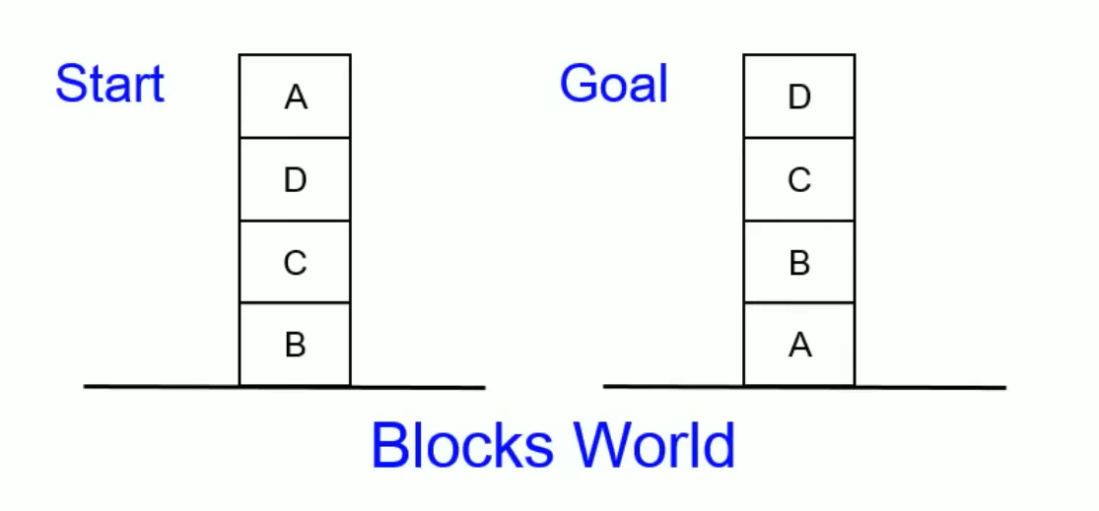
Hill Climbing: Global Heuristic function
Global heuristic: For each block that has the correct support structure: +1 to every block in the support structure. For each block that has a wrong support structure: -1 to every block in the support structure

Slide 39
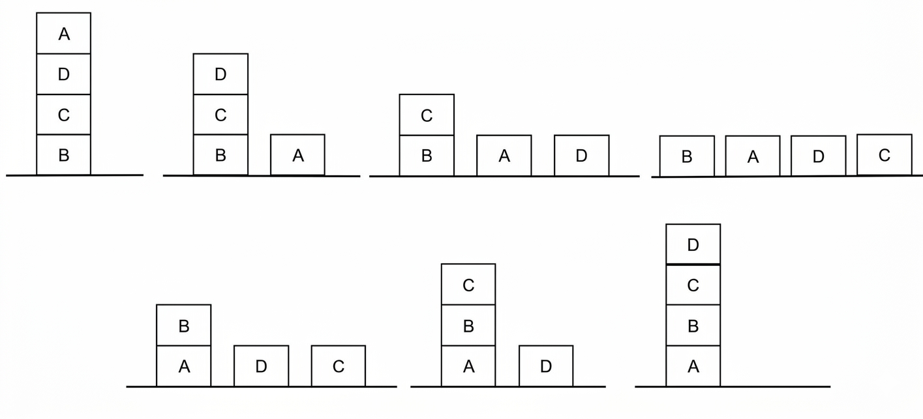
Hill Climbing: Global Heuristic function

Slide 40
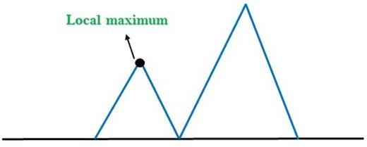
Drawbacks of Hill Climbing — Local Maxima
A peak higher than all immediate neighbors, but below the global maximum.
The algorithm sees no upward move and stops.
A better solution exists elsewhere but is unreachable from here.
Most common failure mode of hill climbing.
SOLUTION: Random-Restart Hill Climbing.
Run the algorithm multiple times from random starting states.
Highly effective: finds global optimum in under 5 restarts on average (8-queens).

Slide 41
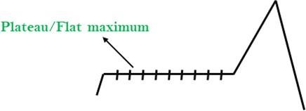
Drawbacks of Hill Climbing — Plateaus
A flat region where all neighbors have the same value.
Algorithm cannot determine which direction leads upward.
Flat local maximum: truly stuck (a genuine plateau peak).
Shoulder: escape is possible if the algorithm keeps going.
Algorithm cannot distinguish the two without extra information.
SOLUTION: Allow sideways moves with a step limit.
Limit sideways steps (e.g., max 100) to avoid infinite loops.

Slide 42
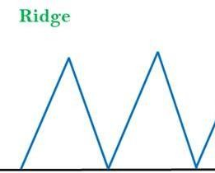
Drawbacks of Hill Climbing — Ridges
A raised region sloped so it cannot be stepped onto directly.
Each attempt lands on a local maximum on the ridge’s side.
Creates a sequence of local maxima along the ridge.
Hill climbing can only move along axes, not diagonally.
Bidirectional search: approach from both ends simultaneously.
Generate diagonal successors: allow multi-dimension moves.
Simulated Annealing: probabilistic jumps naturally handle ridges.

Slide 43
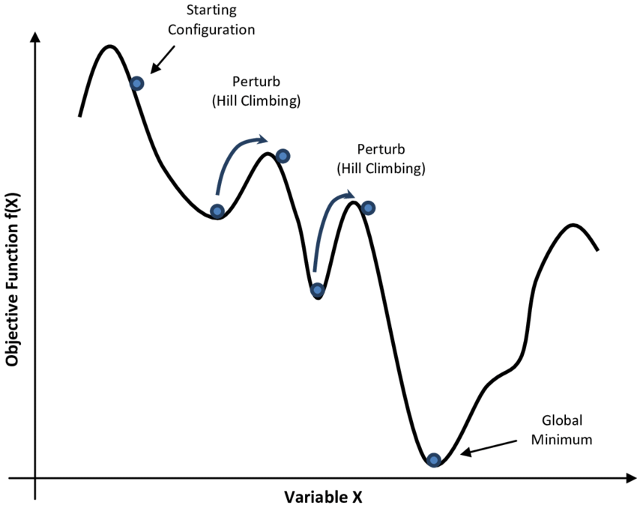
Simulated Annealing
Solves the main problem with hill climbing: getting stuck in local maxima.
Picks a random move (not the best move).
Always accepts improvements (delta E > 0).
Accepts bad moves with probability e^(ΔE/T).
Temperature T controls exploration vs. exploitation.
High T → explore freely; Low T → settle into best path.
Temperature decreases over time via an annealing schedule.
Applications: VLSI Layout, Factory Scheduling, Travelling Salesman Problem.

Slide 44
Simulated Annealing — Algorithm
Start at an initial state.
1
Pick a random neighbor (not the best one).
2
If it is better, always move to it.
3
If it is worse, move to it with a probability based on temperature T.
4
Slowly lower the temperature over time.
5
Stop when temperature reaches zero.
6

Slide 45
WHAT IS ADVERSARIAL SEARCH?
"Two players compete. Each tries to WIN while assuming the opponent plays PERFECTLY."
🎯 Two Players
⚔️ Competitive
🧠 Perfect Info
One tries to MAXIMIZE score. The other tries to MINIMIZE it. Both act rationally.
What is good for one player is bad for the other — a zero-sum game.
Both players see the full game state — like Chess or Tic-Tac-Toe.

Slide 46
THE GAME TREE
Every possible game state forms a tree:
MAX
🌱 Root = current game state
🔀 Each branch = one possible move
📄 Leaf = game over (win/lose/draw)
↕️ Alternate between MAX and MIN players
MIN
MIN
3
12
8
2
Utility Values (Leaf Nodes)

Slide 47
REAL-WORLD APPLICATIONS
♟️ Chess & Checkers
🎮 Video Game AI
Evaluated millions of positions per second using Minimax + Alpha-Beta pruning.
Non Player Characters use adversarial search to make intelligent decisions against players in strategy and fighting games.
🃏 Card & Board Games
🤖 Robotics & Planning
Includes probabilities and pattern matching for hidden information.
Competitive scenarios where robots or agents make decisions against others.

Slide 48
Type of games in AI
Perfect Information
Imperfect Information
Both player can see everything. Evaluates millions of positions per second. Eg:Chess
Some information is hidden. Player must guess or predict. Eg: Card games
Deterministic games:
Non-deterministic games:
Result is fixed and predictable. No luck and randomness. Eg:Tic-Tac-Toe
Result is not fixed. Same input can give different output. Eg:Ludo

Slide 49
Type of games in AI
Competitive Games
Cooperative Games
Players compete against eachother. Eg:Chess
Players work together to achieve goals. Eg:Multi-agent team work games

Slide 50
Mini-Max Search

Slide 51
Introduction
Min max is used in game playing AI.
It helps to choose the best move.
There are two types of player:
Max -> Tries to maximize score
Min ->Tries to minimize score
The algorithm assumes opponent plays perfectly.
Example : Tic-Tac-Toe, chess.

Slide 52
How it works?
Game is represented as tree.
Steps:
Generate all possible moves.
Go to the end (terminal state).
Assign Values (win=+1,loose=-1,draw=0).
Max chooses the highest value and min chooses the lowest value.

Slide 53
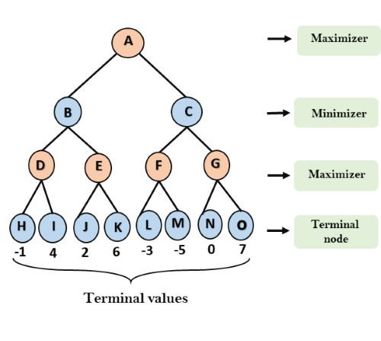
Min-Max Search

Slide 54
Alpha-Beta Pruning
Optimization of Min-Max. (Advance version)
Reduces number of nodes evaluated.
Skips unnecessary calculations.
Alpha(@):Best value for max.
Beta(B):Best value for min.
If @>=B stop.

Slide 55
How it Works?
Start from root.
1
Traverse tree like min-max.
2
Apply pruning when condition meets.
3
Ignore useless branch.
4

Slide 56
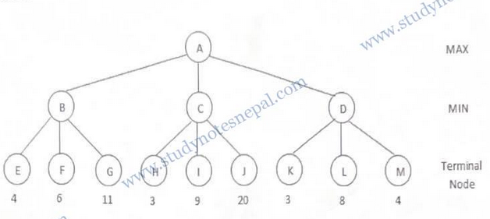
Old is Gold Question

Slide 57
Constraint Satisfaction Problem
CSP is a problem where we assign values to variables while satisfying constraints.
Find Valid solutions without breaking rules.
It has 3 parts:
Variables(X)
Domains(D)
Constraints(C)
Applications : Sudoku, Puzzle Solving

Slide 58
Map Coloring Problem
Regions must have different color.
No two neighbors should have same color.

Slide 59
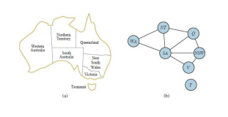
Map Coloring Problem

Slide 60
Explanation
X={WA,NT, Q, NSW, V, SA, T}
Domain={red,green,blue}
C = {SA ≠ WA, SA ≠ NT, SA ≠ Q,SA ≠ NSW,SA ≠ V, WA ≠ NT,NT ≠ Q,Q ≠ NSW,NSW ≠ V}
WA=red, NT=green, Q=red, NSW=green, V =red, SA=blue, T =red

Slide 61
Thank You

